Slide 1
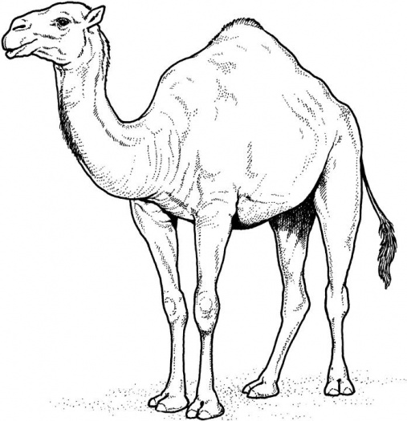
Name_______________________________ Date__________
Camels have large, broad feet that expand when stepped on and contract when lifted to simplify walking in sand or snow.
Camels have double rows of extra-long eyelashes that help keep sand out of the eyes. How many rows of eyelashes do 7 camels have?
Camels can easily carry an extra 400 pounds while walking 20 miles a day in the harsh desert. How many days would it take to walk 100 miles?
If I had to move 1,600 pounds of supplies across the desert, how many camels would I need?
The camel hump weighs around 80 pounds. It is made up of pure fat. A camel can go without food and water for a long time because of the fat in its hump and the camel’s ability to store water. If a camel uses 5 pounds of fat each day, how many days will the 80 pounds of fat keep the camel alive in the desert where there is no food or water?
A camel uses up about 5 gallons of water a day in the summer. How much water is needed each day for 200 camels?
composite
prime
The average camel weighs 1100 pounds. How much would 25 camels weigh?
Camels, native to the Gobi Desert in China grow a shaggy coat in the winter for protection from the freezing cold and shed the coat during the hot summer. They can survive a wide range of temperatures, from minus 20 degrees Fahrenheit to 120 degrees Fahrenheit! If a normal day is 75 degrees Fahrenheit, how much more heat can a camel tolerate?

