Slide 1
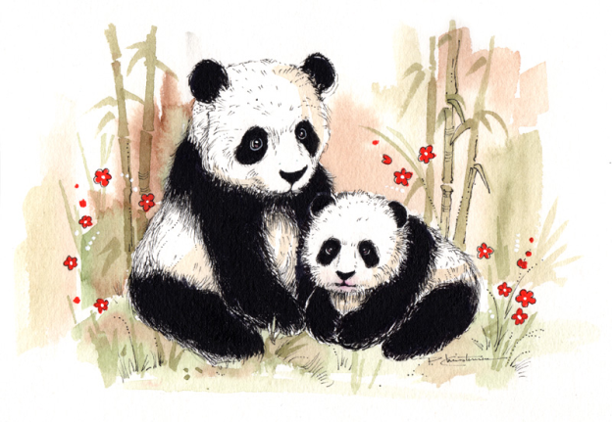
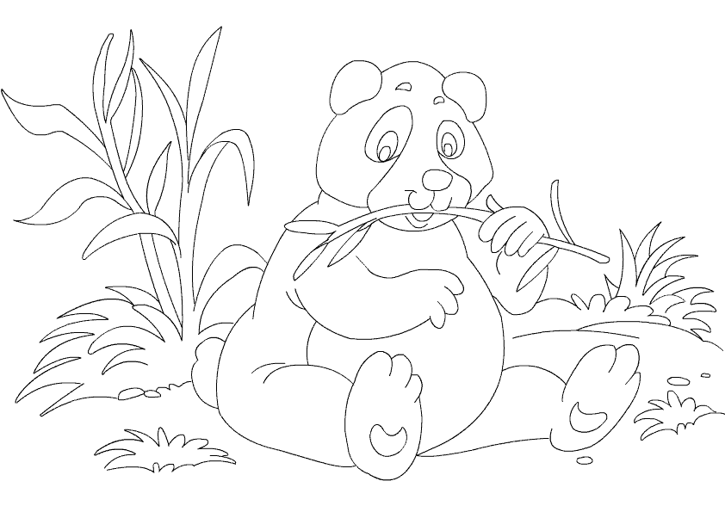
Name_________________________ Date___________
There are 24 hours in one day. Pandas eat bamboo for around 12 hours each day. What fraction of the day do pandas spend eating bamboo?
Pandas spend at least 12 hours each day eating bamboo. In 31 days, how many hours will the panda spend eating bamboo?
Today, an estimated 2,000 pandas are found in the wild. There are also 180 pandas found in captivity. How many more pandas are found in the wild than in captivity?
Male pandas weigh around 250 pounds and female pandas weigh around 220 pounds. How much more do male pandas weigh than female pandas?
Pandas can eat up to 45 pounds of bamboo in one day. If the panda eats five meals a day, how many pounds of bamboo does the panda eat at each meal?
Pandas usually have only one cub at a time. What is special about the number 1? Show three different ways to write the number 1. (Identity Property)

