Slide 1
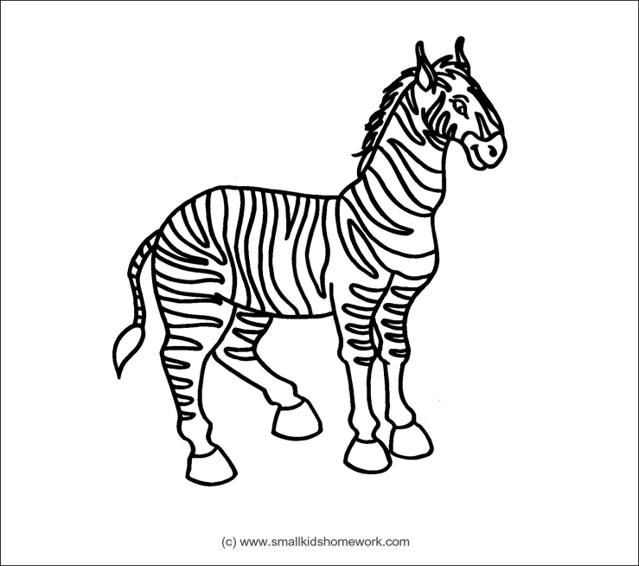
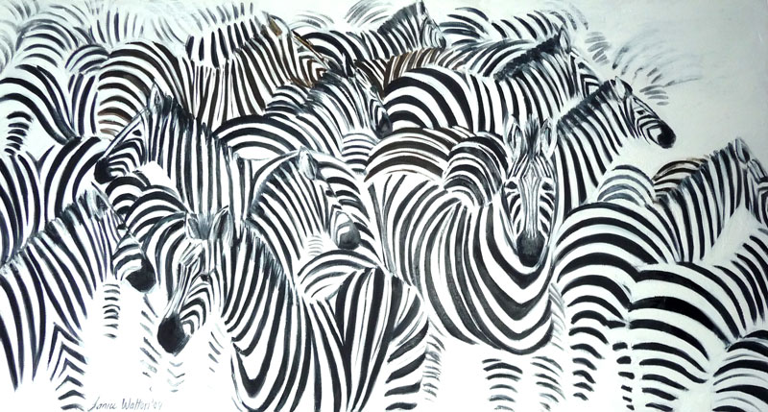
Name______________________________ Date____________
Zebra teeth never stop growing. Most zebras have 44 teeth, just like horses. Most people have 32 teeth. How many more teeth do zebras have than people?
Prime
Each zebra has its own unique pattern of distinctive stripes, just as humans have their own unique pattern of fingerprints. There are around 20 zebras in each zebra family. If there were 18 zebra families, how many zebras would there be?
The Grant zebra are famous for spectacular migrations during the rainy season in the Serengeti, when as many as 10,000 of these animals can be seen journeying together in herds. If the herd was divided equally into two groups, how many zebras would be in each group?
In 1977 there were 13,718 zebras in the African herd. In 1988, there were 4,278 African zebras left. How many zebras were lost between 1977 and 1988?
Zebras can gallop at 40 miles per hour. If a car travels at 55 miles per hour, how much faster is the car?
Composite

