Slide 1
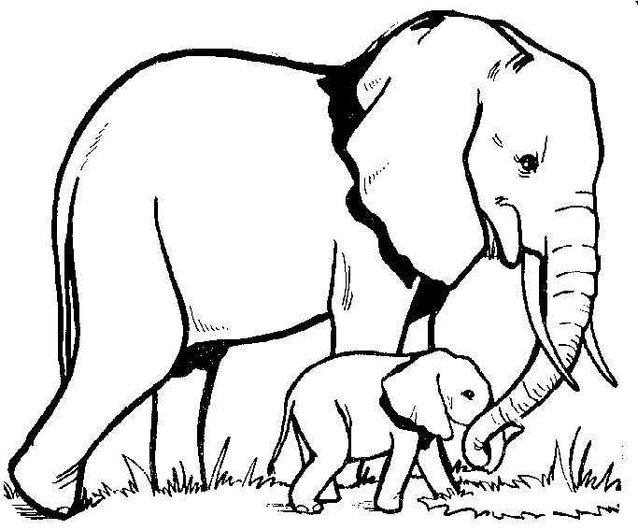
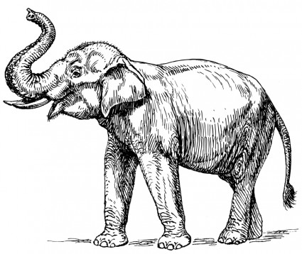
Name____________________________Date__________
Elephants at the Zoo eat up to 125 pounds of food each day and they each deposit about 300 pounds of poop daily. How is this possible? It’s due to all the water they drink. How many pounds of poop would 40 elephants leave in one day?
Elephants can swim – they use their trunk to breathe like a snorkel in deep water. If there are 357 elephants under the water and 2349 grazing on the grassland, how many elephants are there in all?
Elephants are the largest land-living mammal in the world and can grow up to 13 feet tall. Unlike other mammals, elephants grow throughout their lifetime. How many elephants would be needed to reach to the top of the Bank of America building in Atlanta (1040 feet)?
4 prime numbers:
A baby elephant, a calf, is around 3 feet tall. There are 12 inches in every foot. How many inches tall are baby elephants?
The low, resounding calls elephants make can be heard by another elephant up to 5 miles away. Humans can only hear other humans within less than ½ of a mile. How many times stronger is elephant hearing?

