Slide 1
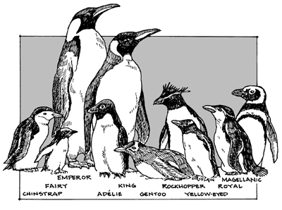
Name_________________________ Date___________
There are 17 species of penguins, all living in the Southern Hemisphere. The average life span of an Emperor Penguin is around 20 years. The average life span of a human is around 80 years. How much longer does a human live than a penguin?
The Artic temperatures range from -20 degrees Celsius to -50 degrees Celsius. The wind can gust up to 124 miles per hour. The Emperor Penguin is the only animal to inhabit the open ice during winter. The population of Emperor Penguins in Antarctica is about 297,500 mating pairs. What is the total population of the Penguin?
The Emperor Penguin is the tallest and heaviest of all the penguins. The average heights is 48inches and they average around 80 pounds. If there 12 inches in a foot, how many feet tall are most Emperor Penguins?
The speed of the Emperor Penguin in the water is around 6 to 9 miles per hour. They need to be fast to avoid being caught by their predator, the Leopard Seal. The Leopard Seal eats about 5 penguins a day. If a penguin swims at the rate of 6 mph how far can they travel in 4 hours?
The female penguin lays one egg per year. The male penguin holds the egg on his feet for nine weeks. Show the three ways to represent the number 9.
When the male penguins are holding their eggs they huddle in a group of about 5,000 called a colony. During this time the male penguin does not eat. They lose 40% of their body weight. What is 40% of 80?

