Slide 1
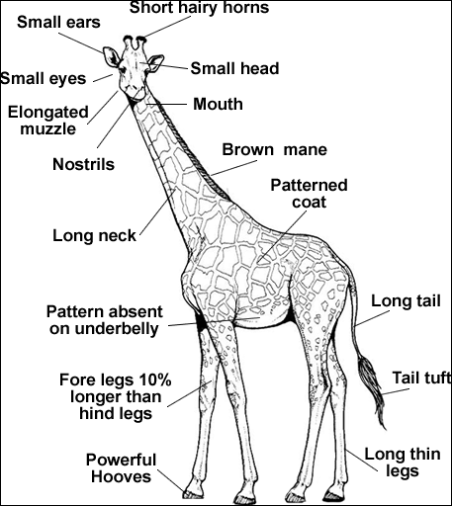
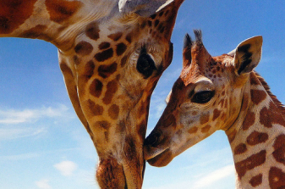
Name___________________________ Date_____________
Giraffes are the tallest land animals. A giraffe could look into a second-story window without even having to stand on its tiptoes!
In a herd of giraffes, half are male and half are female. What equivalent fractions could show the number of male giraffes in the heard? List as many as you can.
Males, up to 18 feet tall; females, up to 14 feet tall. How much taller are the male giraffes than the female giraffes?
A giraffe's feet are the size of a dinner plate—12 inches across. What would be the total length if we lined up 15 giraffe feet end to end?
List 5 prime numbers between 25 and 100.
A giraffe's 6-foot-long neck weighs about 600 pounds. How much would 100 giraffe necks weigh?
Calves are 6 feet tall at birth!
List 2 composite numbers.

